Slide 1
Analysis of Algorithms

Slide 2
Data Structures and Algorithms
Algorithm: Outline, the essence of a computational procedure, step-by-step instruction.
Program: An implementation of an algorithm in some programming language
Data Structure: Organization of data needed to solve the problem

Slide 3
Data Structures and Algorithms
Data Structure:
a systematic way of organizing and accessing data.
array, list, stack, queue, tree, graph.
insertion, deletion, sorting, searching.

Slide 4
Analysis of Algorithm – Why???
To separate bad algorithm from good algorithm.
To choose the most effective approach for our problem solving.

Slide 5

Analysis of Algorithm
An algorithm can be analyzed in terms of
time efficiency or space utilization.

Slide 6
Time Complexity
The running time of an algorithm is
influenced by several factors:
Language in which the program was written.
For example, programs written in assembly language generally run faster than those written in C or C++, which in turn tend to run faster than those written in Java.
Efficiency of the compiler that created the program.
The size of the input: processing 1000 records will take more time than processing 10 records.
Organization of the input: if the item we are searching for is at the top of the list, it will take less time to find it than if it is at the bottom.

Slide 7
Beyond Experimental Studies
General method for analyzing running time of algorithms involve:
High level description of an algorithm
Takes into account all possible input
Evaluate its efficiency independent of the s/w and h/w environment.

Slide 8
Pseudo- Code
A mixture of natural language and high-level programming concepts that describes the main idea behind a generic implementation of a data structure or algorithm
Eg.
Algorithm arrayMax(A, n):
Input: an array storing n integers
Output: The maximum element in A
Current Max <- A[0]]
for i <- 1 to n-1 do
If currentMax < A[i] then currentMax <-A[i]
return currentMax

Slide 9
Pseudo Code
It is more structured than usual prose but less formal than a programming language
Expressions:
Use standard mathematical symbols to describe numerical and boolean expressions.
Use <- for assignment (“=“)
Use = for equality relationship (“==“)
Method Declaration
Algorithm name(param1, param2)

Slide 10
Pseudo Code
Programming Constructs:
Decision structures: if… then… [else…]
While-loops: while… do
Repeat loops: repeat… untill….
For loop: for .. do
Array indexing: A[i], A[i,j]
Methods:
Calls: method(arg)
Return: return valures

Slide 11
Analysis of algorithms
Primitive operations: Low level operation independent of programming language.
Data Movement (assign)
Control (branch, subroutine call, return)
Arithmetic and logical operations (e.g. addition, comparison)
By inspecting the pseudo code we can count the number of primitive operations executed by an algorithm

Slide 12
The Execution Time of Algorithms
Each operation in an algorithm (or a program) has a cost.
Each operation takes a certain of time.
count = count + 1; // take a certain amount of time, but it is constant
A sequence of operations:
count = count + 1; Cost: c₁
sum = sum + count; Cost: c₂
➔ Total Cost = c₁ + c₂

Slide 13
The Execution Time of Algorithms (cont.)
Example: Simple If-Statement
Cost Times
if (n < 0) c1 1
absval = -n c2 1
else
absval = n; c3 1
Total Cost <= c1 + max(c2,c3)

Slide 14
The Execution Time of Algorithms (cont.)
Example: Simple Loop
Cost Times
i = 1; c1 1
sum = 0; c2 1
while (i <= n) { c3 n+1
sum = sum + i; c4 n
i = i + 1; c5 n
}
Total Cost = c1 + c2 + (n+1)*c3 + n*c4 + n*c5
➔ The time required for this algorithm is proportional to n

Slide 15
The Execution Time of Algorithms (cont.)
Example: Nested Loop
Cost Times
i=1; c1 1
sum = 0; c2 1
while (i <= n) { c3 n+1
j=1; c4 n
while (j <= n) { c5 n*(n+1)
sum = sum + i; c6 n*n
j = j + 1; c7 n*n
}
i = i +1; c8 n
}
Total Cost = c1 + c2 + (n+1)*c3 + n*c4 + n*(n+1)*c5+ n*n*c6+ n*n*c7+ n*c8
➔ The time required for this algorithm is proportional to n²

Slide 16
Run Times
Notation – O (Big-Oh)
1.O(c) to mean a computing time which is a constant RT.
2.O(n) →Linear
3.O(n²) →Quadratic
4.O(n³) →Cubic
5.O(2^{n}) →Exponential.
6. O(log n) →Logarithmic
O(n log n)

Slide 17
General Rules
RULE 1-FOR Sequential Logic: O(c)
Any algorithm which exhibits sequential logic without any looping logic exhibits a constant run time – O(c)

Slide 18
General Rules
RULE 2-FOR LOOPS: O(n)
The running time of a for loop is at most the running time of the statements inside the for loop (including tests) times the number of iterations.

Slide 19
General Rules
RULE 3-NESTED FOR LOOPS: O(n²)
The total running time of a statement inside a group of nested for loops is the running time of the statement multiplied by the product of the sizes of all for loops.

Slide 20
General Rules
RULE 3-CONSECUTIVE STATEMENTS:
These just add i.e., the maximum is the one that counts
As an example, the following program fragment, which has O(N) work followed by O(N²) work, is also O(N²)
for( i=0; i<n; i++)
a[i] = 0;
for( i=0; i<n; i++ )
for( j=0; j<n; j++ )
a[i] += a[j] + i + j;

Slide 21
General Rules
RULE 4-lF/ELSE:
if ( cond )
S1
else
S2
The running time of an if/else statement is never more than the running time of the test plus the larger of the running times of S1 and S2.

Slide 22
General Rules
If the recursion is really just a thinly veiled for loop, the analysis is usually trivial. For instance, the following function is really just a simple loop and is obviously O(N):
unsigned int factorial( unsigned int n )
{
if( n <= 1 )
return 1;
else
return( n * factorial(n-1) );
}
When recursion is properly used, it is difficult to convert the recursion into a simple loop structure.

Slide 23
General Rules
Logarithms in the Running Time: (Divide and Conquer method)
An algorithm is O(log N) if it takes constant O(1) time to cut the problem size by a fraction (which is usually ½ ).

Slide 24
Time Complexity
n | log₂n | nlogn | n² | n³ | 2^{n}
1 | 0 | 0 | 1 | 1 | 2
2 | 1 | 2 | 4 | 8 | 4
3 | 1.584963 | 4.754888 | 9 | 27 | 8
4 | 2 | 8 | 16 | 64 | 16
5 | 2.321928 | 11.60964 | 25 | 125 | 32
6 | 2.584963 | 15.50978 | 36 | 216 | 64
7 | 2.807355 | 19.65148 | 49 | 343 | 128

Slide 25
The Growth Rate of the Six Popular functions
n | logn | nlogn | n² | n³ | 2^{n}
4 | 2 | 8 | 16 | 64 | 16
8 | 3 | 24 | 64 | 512 | 256
16 | 4 | 64 | 256 | 4,096 | 65,536
32 | 5 | 160 | 1,024 | 32,768 | 4,294,967,296
64 | 6 | 384 | 4,094 | 262,144 | 1.84 * 10¹⁹
128 | 7 | 896 | 16,384 | 2,097,152 | 3.40 * 10³⁸
256 | 8 | 2,048 | 65,536 | 16,777,216 | 1.15 * 10⁷⁷
512 | 9 | 4,608 | 262,144 | 134,217,728 | 1.34 * 10¹⁵⁴
1024 | 10 | 10,240 | 1,048,576 | 1,073,741,824 | 1.79 * 10³⁰⁸

Slide 26
Time Complexity

Slide 27
Notations for algorithmic analysis
O(n) represents upper bound.
Θ(n) means tight bound.
Ω(n) represents lower bound.

Slide 28
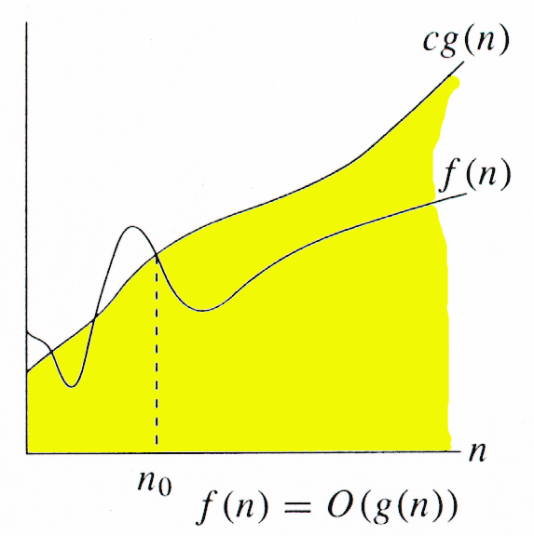
O(n) represents upper bound.
(big-oh)
f(x) < = O(g(x))
means that the growth rate of f(x) is asymptotically less than or equal to the growth rate of g(x)

Slide 29
Big-O notation (Cont.,)
“The largest terms dominate”
The dominant term is the term that grows most quickly as n becomes large.
If you calculated that an algorithm took n² + 3n + 1 of work, the proper and correct Big-O notation is O(n²)
The O(n²) is the dominate term and the 3n + 1 part is considered negligible

Slide 30
Examples: Big – O Notation
3n²+4n+1=O(n²)
7n³+5n²+6n+2=O(n³)
7n³+5n³+6n+2=O(n⁴)
6+2^{n}+n²=O(2^{n})
Show that the following are incorrect
10n²+9=O(n)
n³2^{n}+6n²3^{n}=O(n³2^{n})

Slide 31
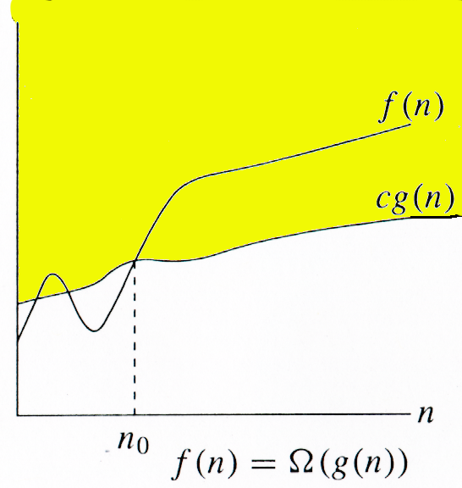
Ω(n) represents lower bound
(big-omega)
f(x) > = Ω(g(x))
means that the growth rate of f(x) is asymptotically greater than or equal to the growth rate of g(x)

Slide 32
Examples: Ω – Omega Notation
3n²+4n+1=Ω(n²)
7n³+5n²+6n+2=Ω(n³)
7n³+5n²+6n+2=Ω(n²)
62^{n}+n²=Ω(2^{n})
Show that the following are incorrect
10n²+9= Ω(n³)
2^{n=} Ω(3^{n})

Slide 33
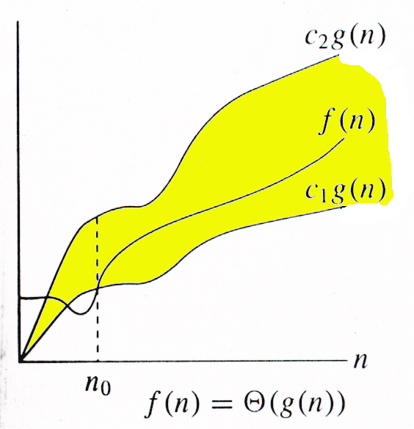
Θ(n) means tight bound
(theta)
f(x) = Θ(g(x)) means that the growth rate of f(x) is asymptotically equal to the growth rate of g(x)

Slide 34
Examples: Theta Notation
3n²+4n+1=Θ(n²)
7n³+5n³+6n+2=Θ(n³)
62^{n}+n²=Θ(2^{n})
3+1/n= Θ(1)
4n logn+7n= Θ(n log n)
Show that the following equalities are incorrect
(1) n² log n= Θ(n²)
(2) ) n^{2 /} log n= Θ(n²)

Slide 35
Examples of Time complexity

Slide 36
Example: 1
Problem : Sum of the given n numbers
Sum() Times
read n 1
sum=0 1
for( int i=1; i<= n; i++) n+1
read ( num) n
sum=sum+num n
end for 1
end 1
The Time Complexity of algorithm is 1+1+n+1+n+n+1+1=3n+5 =O(n)= Ω(n)=Θ(n)

Slide 37
Example: 2
Matrix Addition:
Mat add( a[], b[],n) Times
for(i=0;i<n;i++) n+1
for(j=0;j<n;j++) (n)(n+1)
c[i][j]=a[i][j]+b[i][j]; n²
end for 1
end for 1
end 1
∴T(n)= n+2n²+1+1+1=2n²+n+3
=O(n²)=Ω(n²)=Θ(n²)

Slide 38
Example: 3
Example for log₂n
main()
{
int i,n;
n=100;
for(i=n;i>0;i=i/2)
printf("%d\n",i);
getch();
}

Slide 39
Example: 4 – Try Out!!!
void main( )
{
int arr[5] = { 12,13,10,11,15 } ;
int i, j, k,n, temp ;
n=5;
printf("\n");
for ( i = 0 ; i < n-1 ; i++ )
{
for(j=0; j<n-1; j++)
{
if(arr[j]>arr[j+1])
{
temp=arr[j];
arr[j]=arr[j+1];
arr[j+1]=temp;
}}}

Slide 40

Example:5 – Try Out!!!
for(i=1;i<=n;i++) n+1
for(j=1;j<=i;j++)
for(k=1;k<=j;k++)
X=x+1;

Slide 41
Example:6 – Try Out!!!
for(i=1;i<=n;i++) n+1
for(j=1;j<=n;j++) n(n+1)
for(k=1;k<=n;k++) nxn(n+1)
X=x+1; nxnxn

Slide 42
Example:7 – Try Out!!!
i = 1;
while(i <= n)
{
x=x+1;
i=i+1;
}

Slide 43
Time Complexities
Best Case
Measure the minimum time that the algorithm will require for an input of size n.
Worst Case
Measure the maximum time that the algorithm will require for an input of size n.
Average Case
Averaging the running time of an algorithm for all possible input of size n.

Slide 44
Algorithm - Linear Search
Objective:
Design an algorithm to search a given value in an array.
Assumptions:
Let the array A is unordered.

Slide 45
Algorithm Name:
LinearSearchArray(A, N, LB, UB, X, R)
Input :
A is any numeric array with N number of elements, we have to search X in the given array A.
LB & UB are the Lower Bound & Upper Bound of the array segment where we are going to search for the element X.
Output:
R will hold -1 if X is not found in the array A, otherwise R will hold the index of X in the given array A.

Slide 46
Algorithm – Linear Search
R ← -1
i ← LB
WHILE ( i <= UB )
IF ( A[i] = X ) Then
R ← i
EndIf
i ← i + 1
End While
Return

Slide 47
Analysis of Linear Search
1
1
n
n
1 or 0
n
n
1
1
1 + 1 + n + n +1+n+n+1+1 = 4n+5 = O(n)
Best Case: O(1)
Worst Case & Average Case: O(n)

Slide 48
Algorithm - Binary search
left←1
right←n
do
mid←(left+right)/2
if A[mid]=q then return mid
else if A[mid]>q then right←mid-1
else left=mid+1
while left<=right
return NIL
Idea: Divide and conquer, one of the key design techniques

Slide 49
Binary search – analysis
How many times the loop is executed:
With each execution the difference between left and right is cult in half
Initially the difference is n
The loop stops when the difference becomes 0
How many times do you have to cut n in half to get 1?
log n

Slide 50
Example: Sorting
INPUT
sequence of numbers
OUTPUT
a permutation of the sequence of numbers
Sort
a₁, a₂, a₃,….,a_{n}
b₁,b₂,b₃,….,b_{n}
2 5 4 10 7
2 4 5 7 10
Correctness (requirements for the output)
For any given input the algorithm halts with the output:
b₁ < b₂ < b₃ < …. < b_{n}
b₁, b₂, b₃, …., b_{n} is a permutation of a₁, a₂, a₃,….,a_{n}
Running time
Depends on
number of elements (n)
how (partially) sorted they are
algorithm

Slide 51
Insertion Sort
A
3
4
6
8
9
7
2
5
1
1
j
n
i
Strategy
Start “empty handed”
Insert a card in the right position of the already sorted hand
Continue until all cards are inserted/sorted
INPUT: A[1..n] – an array of integers
OUTPUT: a permutation of A such that A[1]≤ A[2]≤ …≤A[n]
for j←2 to n
do key←A[j]
Insert A[j] into the sorted sequence A[1..j-1]
i←j-1
while i>0 and A[i]>key
do A[i+1]←A[i]
i--
A[i+1]←key

Slide 52
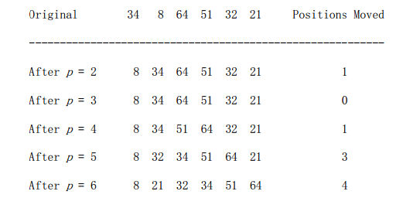
Insertion Sort - Execution

Slide 53
Analysis of Insertion Sort
Time to compute the running time as a function of the input size
for j←2 to n | c1 | n
do key←A[j] | c2 | n-1
i←j-1 | c3 | n-1
while i>0 and A[i]>key | c4
do A[i+1]←A[i] | c5
i-- | c6
A[i+1] ← key | c7 | n-1

Slide 54
Best/Worst/Average Case
Best case: elements already sorted → t_{j}=1, running time = f(n), i.e., linear time.
Worst case: elements are sorted in inverse order → t_{j}=j, running time = f(n²), i.e., quadratic time
Average case: t_{j}=j/2, running time = f(n²), i.e., quadratic time

Slide 55
Selection Sort
Selection sort:
First finds the smallest element in the list and place it in the first position.
Then it finds the second smallest element and place it in the second position.
This will continue till the last element in the list.

Slide 56
Selection Sort - Algorithm
Alg.: SELECTION-SORT(A)
n ← length[A]
for j ← 1 to n - 1
do smallest ← j
for i ← j + 1 to n
do if A[i] < A[smallest]
then smallest ← i
exchange A[j] ↔ A[smallest]

Slide 57
Example
8
4
6
9
2
3
1
1
2
3
4
9
6
8
1
4
6
9
2
3
8
1
2
3
4
6
9
8
1
2
6
9
4
3
8
1
2
3
4
6
8
9
1
2
3
9
4
6
8
1
2
3
4
6
8
9

Slide 58
Analysis of Selection Sort
cost times
c₁ 1
c₂ n
c₃ n-1
c₄
c₅
c₆
c₇ n-1
Alg.: SELECTION-SORT(A)
n ← length[A]
for j ← 1 to n - 1
do smallest ← j
for i ← j + 1 to n
do if A[i] < A[smallest]
then smallest ← i
exchange A[j] ↔ A[smallest]
n²/2
comparisons
n
exchanges

Slide 59
Pattern Matching
//(Pattern)P and T are strings with length R and S respectively
1. Set k := 1 and MAX := S – R +1
2. Repeat Steps 3 to 5 while k <=MAX
3. Repeat for L = 1 to R
If P[L] != T[K+L-1] then Go to Step 5
[End of inner loop]
4. [Success] Set INDEX = k, and Exit.
5.Set k = k+1
[End of step 2 outer loop]
6.[Failure] Set INDEX =0.
7.Exit

Slide 60
Example 1
T: x y x y y x x y x y x y y
P: x y x y x y y
Example 2
P: star
T: twinkletwinklelittlestar
Example 3
P:aaba
T:aaaaaababbbaa

Slide 61
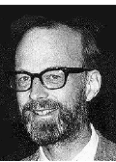
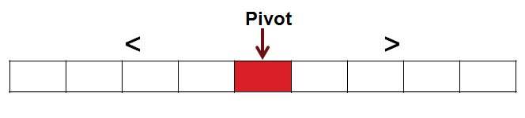
Quick Sort
Quicksort was invented in 1960 by C. A. R. Hoare.
A divide and conquer sorting algorithm
Ɵ(n log n) expected running time on an average.
Ɵ(n²) worst case running time.

Slide 62
Quick Sort
Divide: Partition (rearrange) the array A[p . . r] into two (possibly empty) subarrays, A[p . . q −1] and A[q +1 . . r] such that each element of A[p . . q −1] is less than or equal to A[q], which is, in turn, less than or equal to each element of A[q + 1 . . r]. Compute the index q as part of this partitioning procedure.
Conquer: Sort the two subarrays A[p . . q−1] and A[q +1 . . r] by recursive calls to quicksort.
Combine: Since the subarrays are sorted in place, no work is needed to combine them: the entire array A[p . . r] is now sorted.

Slide 63
Quick Sort
The following procedure implements quick sort.
QUICKSORT(A, p, r)
1 if p < r
2 then q ← PARTITION(A, p, r)
3 QUICKSORT(A, p, q − 1)
4 QUICKSORT(A, q + 1, r)
To sort an entire array A, the initial call is QUICKSORT(A, 1, length[A]).

Slide 64
Quick Sort
PARTITION(A, p, r)
1 x ← A[r]
2 i ← p − 1
3 for j ← p to r − 1
4 do if A[ j ] ≤ x
5 then i ←i + 1
6 exchange A[i ] ↔ A[ j ]
7 exchange A[i + 1] ↔ A[r]
8 return i + 1
Partitioning the array
The key to the algorithm is the PARTITION procedure, which rearranges the subarray
A[p . . r] in place.
8<4
False
7<4
True
2<4
False
1<4
True
r
i and j are same so swapping happens in the same place
i
P
x
j
2 | 8 | 7 | 1 | 3 | 5 | 6 | 4
1
8

Slide 65
Loop Invariant
A loop is a programming language statement which allows code to be repeatedly executed;
An invariant of a loop is a property that holds before (and after) each repetition.

Slide 66
Merge Sort
Merge sort is based on the divide-and-conquer paradigm.
A[p .. r]. Initially, p = 1 and r = n
To sort A[p .. r]:
1. Divide Step
If a given array A has zero or one element, simply return; it is already sorted. Otherwise, split A[p .. r] into two subarrays A[p .. q] and A[q + 1 .. r], each containing about half of the elements of A[p .. r]. That is, q is the halfway point of A[p .. r].
2. Conquer Step
Conquer by recursively sorting the two subarrays A[p .. q] and A[q + 1 .. r].
3. Combine Step
Combine the elements back in A[p .. r] by merging the two sorted subarrays A[p .. q] and A[q + 1 .. r] into a sorted sequence. To accomplish this step, we will define a procedure MERGE (A, p, q, r).

Slide 67
Merge Sort Algorithm
MERGE-SORT (A, p, r)
1. IF p < r // Check for base case 2. THEN q = FLOOR[(p + r)/2] // Divide step 3. MERGE-SORT(A, p, q) // Conquer step. 4. MERGE-SORT (A, q + 1, r) // Conquer step. 5. MERGE (A, p, q, r) // Conquer step.
MERGE (A, p, q, r )
1. n1 ← q − p + 1 2. n2 ← r − q 3. Create arrays L[1 . . n1 + 1] and R[1 . . n2 + 1]
Continued in the next slide…

Slide 68
Merge Sort Algorithm (Cont.,)
4. FOR i ← 1 TO n1 5. DO L[i] ← A[p + i − 1] 6. FOR j ← 1 TO n2 7. DO R[j] ← A[q + j ] 8. L[n1 + 1] ← ∞ 9. R[n2 + 1] ← ∞ 10. i ← 1 11. j ← 1 12. FOR k ← p TO r 13. DO IF L[i ] ≤ R[ j] 14. THEN A[k] ← L[i] 15. i ← i + 1 16. ELSE A[k] ← R[j] 17. j ← j + 1

Slide 69
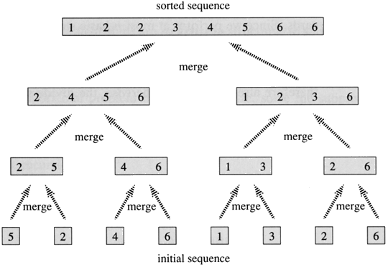
Merge Sort - Example

Slide 70
Shellsort
Founded by Donald Shell and named the sorting algorithm after himself in 1959.
1st algorithm to break the quadratic time barrier but few years later, a sub quadratic time bound was proven
Shellsort works by comparing elements that are distant rather than adjacent elements in an array or list where adjacent elements are compared.

Slide 71
Shellsort
Shellsort uses a sequence h₁, h₂, …, h_{t} called the increment sequence. Any increment sequence is fine as long as h₁ = 1 and some other choices are better than others.

Slide 72
Shellsort
Shellsort makes multiple passes through a list and sorts a number of equally sized sets using the insertion sort.

Slide 73
Shellsort
Shellsort improves on the efficiency of insertion sort by quickly shifting values to their destination.

Slide 74
Shellsort
Shellsort is also known as diminishing increment sort.
The distance between comparisons decreases as the sorting algorithm runs until the last phase in which adjacent elements are compared

Slide 75
Shellsort
After each phase and some increment h_{k}, for every i, we have a[ i ] ≤ a [ i + h_{k} ] all elements spaced h_{k} apart are sorted.
The file is said to be h_{k} – sorted.

Slide 76
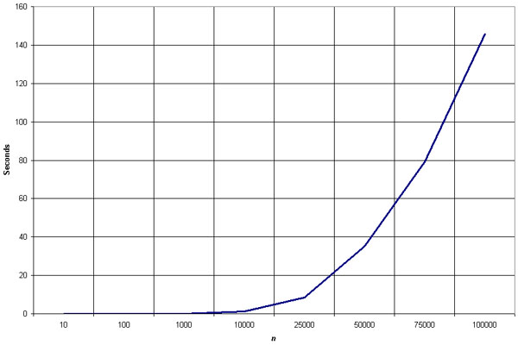
Empirical Analysis of Shellsort
Source: http://linux.wku.edu/~lamonml/algor/sort/shell.html

Slide 77
Empirical Analysis of Shellsort (Advantage)
Advantage of Shellsort is that its only efficient for medium size lists. For bigger lists, the algorithm is not the best choice. Fastest of all O(N^2) sorting algorithms.
5 times faster than the bubble sort and a little over twice as fast as the insertion sort, its closest competitor.

Slide 78
Empirical Analysis of Shellsort (Disadvantage)
Disadvantage of Shellsort is that it is a complex algorithm and its not nearly as efficient as the merge, heap, and quick sorts.
The shell sort is still significantly slower than the merge, heap, and quick sorts, but its relatively simple algorithm makes it a good choice for sorting lists of less than 5000 items unless speed important. It's also an excellent choice for repetitive sorting of smaller lists.

Slide 79
Shellsort Best Case
Best Case: The best case in the shell sort is when the array is already sorted in the right order. The number of comparisons is less.

Slide 80
Shellsort Worst Case
The running time of Shellsort depends on the choice of increment sequence.
The problem with Shell’s increments is that pairs of increments are not necessarily relatively prime and smaller increments can have little effect.

Slide 81
Shellsort Examples
Sort: 18 32 12 5 38 33 16 2
8 Numbers to be sorted, Shell’s increment will be floor(n/2)
* floor(8/2) ➔ floor(4) = 4
increment 4:
1 2 3 4
(visualize underlining)
18 32 12 5 38 33 16 2
Step 1) Only look at 18 and 38 and sort in order ;
18 and 38 stays at its current position because they are in order.
Step 2) Only look at 32 and 33 and sort in order ;
32 and 33 stays at its current position because they are in order.
Step 3) Only look at 12 and 16 and sort in order ;
12 and 16 stays at its current position because they are in order.
Step 4) Only look at 5 and 2 and sort in order ;
2 and 5 need to be switched to be in order.

Slide 82
Shellsort Examples (con’t)
Sort: 18 32 12 5 38 33 16 2
Resulting numbers after increment 4 pass:
18 32 12 2 38 33 16 5
* floor(4/2) ➔ floor(2) = 2
increment 2:
1 2
18 32 12 2 38 33 16 5
Step 1) Look at 18, 12, 38, 16 and sort them in their appropriate location:
12 38 16 2 18 33 38 5
Step 2) Look at 32, 2, 33, 5 and sort them in their appropriate location:
12 2 16 5 18 32 38 33

Slide 83
Shellsort Examples (con’t)
Sort: 18 32 12 5 38 33 16 2
* floor(2/2) ➔ floor(1) = 1
increment 1:
1
12 2 16 5 18 32 38 33
2 5 12 16 18 32 33 38
The last increment or phase of Shell sort is basically an
Insertion Sort algorithm.

Slide 84
Shell Sort Algorithm
void Shellsort( ElementType A[ ], int N )
{
int i, j, Increment;
ElementType Tmp;
for( Increment = N / 2; Increment > 0; Increment /= 2 )
for( i = Increment; i < N; i++ )
{
Tmp = A[ i ];
for( j = i; j >= Increment; j -= Increment )
if( Tmp < A[ j - Increment ] )
A[ j ] = A[ j - Increment ];
else
break;
A[ j ] = Tmp;
}
}

Slide 85
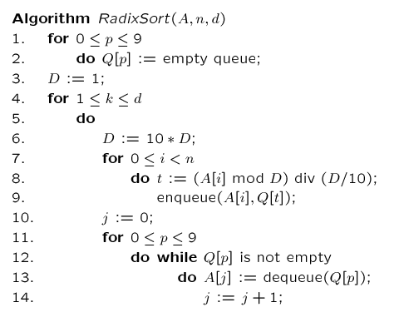
Radix Sort
In each iteration elements will be sorted based on its units, tens, hundred and so on positions.

Slide 86
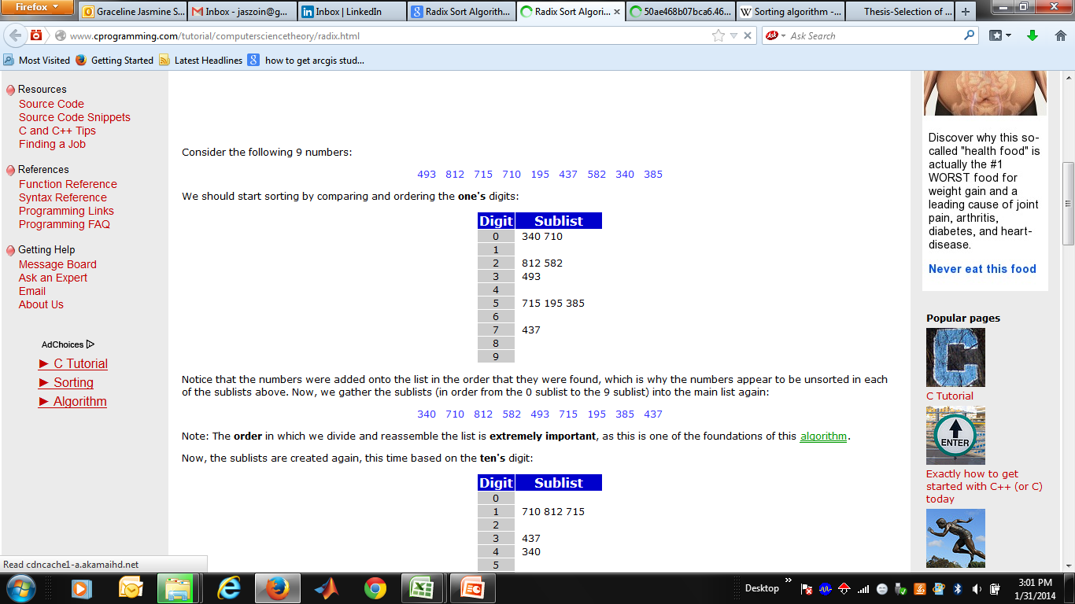
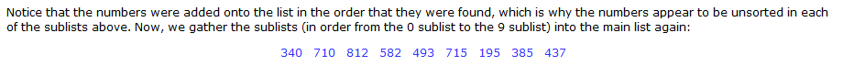
Example for Radix Sort
493 812 715 710 195 437 582 340 385

Slide 87
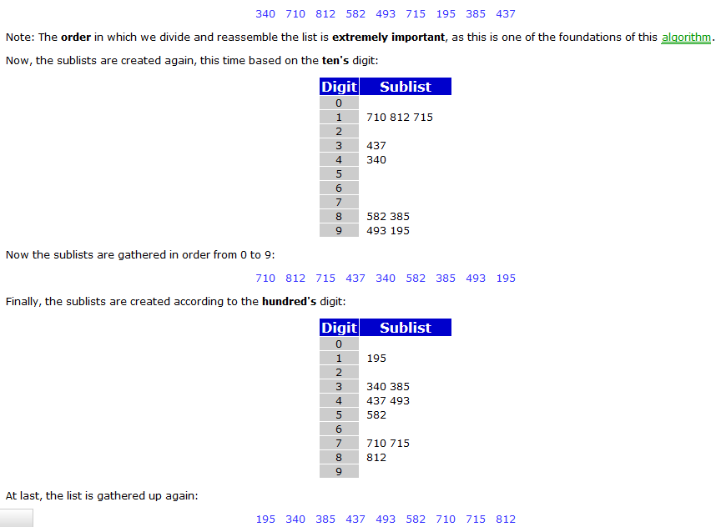
Example for Radix Sort (Cont.,)

Slide 88
Bubble Sor t
One of the simplest sorting algorithms proceeds by walking down the list, comparing adjacent elements, and swapping them if they are in the wrong order. The process is continued until the list is sorted.
The algorithm:
Input: An array A storing N items
Output: A sorted in ascending order
Algorithm Bubble_Sort (A, N):
for i := 1 to N-1 do {
for j := i+1 to N do {
if A[j] > A[i]
temp := A[i], A[i] := A[j], A[j] := temp
}
}
Each pass "bubbles" the largest element in the unsorted part of the list to its correct location.

